Slide 1


DATE 11/12/2024
IWERC’S Media Mention Tool
Kaitlyn Pham - Shih-Yi Chen
Kaixi Zhu - Rashmika Kolleri

Slide 2
Challenges
Proposed Solutions
Key Data Categories
Solution Highlights
Q&A

Slide 3

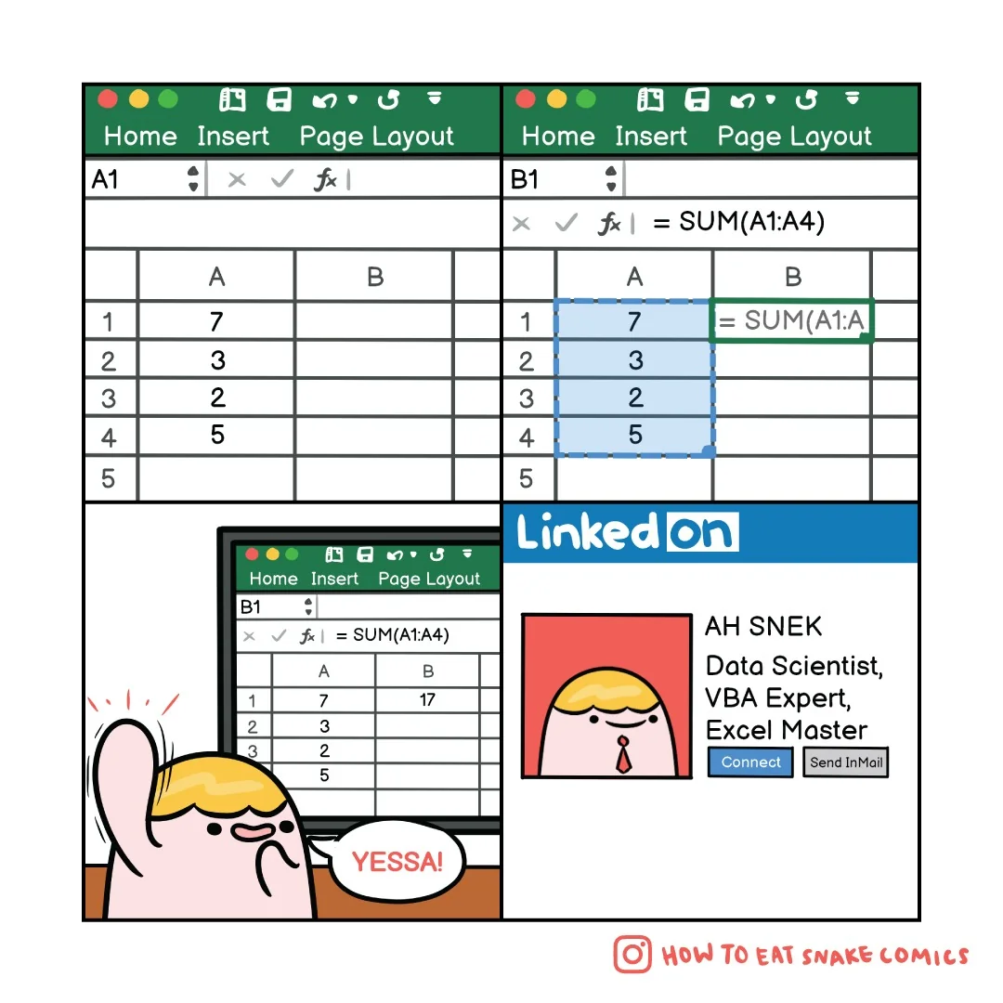

Objectives
Overview:
Challenges:
Solutions:
IWERC (a division of DPI) focuses on advancing research, policy, and educational initiatives
Manually tracking mentioned data using spreadsheets
Positive impacts are not visually represented on their website
Automated Data Extraction Tool
Internal Reporting Dashboard &
Website Dashboard

Slide 4
Four Key Categories of Data Tracking
Information about articles or reports published in various media sources, including title, publication date, author(s), source, and main topics covered.
Publications
Details of presentations, including event name, date, location, presenter(s), audience size, and key topics.
Presentations
Records of when and where a topic, brand, or individual is mentioned across media outlets, including publication, date, mention context, and reach.
Media Mentions
Metrics from social media platforms, including likes, shares, comments, and engagement rates, tied to specific posts or campaigns.
Social Media Interactions

Slide 5
tracking issues

Slide 6
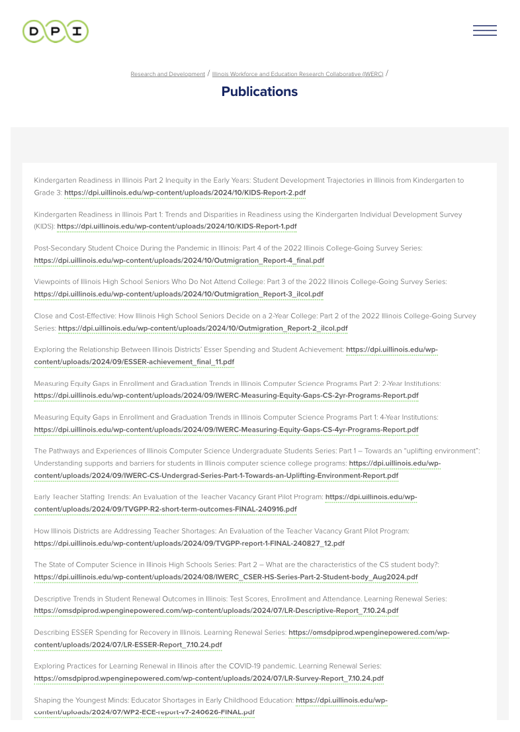
Publications
The existing publication tracking process is overly simple and lacks comprehensive detail.
The current website does not effectively convey the significance and impact of IWERC’s publications and research.

Slide 7
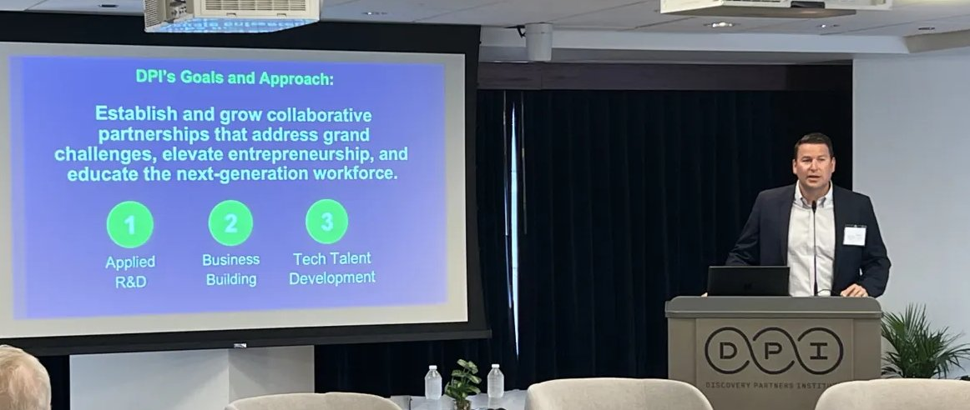
Presentations
Currently, IWERC is tracking presentation data manually through Excel, which results in disorganized and inconsistent data. This makes it difficult to analyze trends and track performance.
The current tracking does not effectively convey the significance of IWERC’s presentations or their impact.

Slide 8

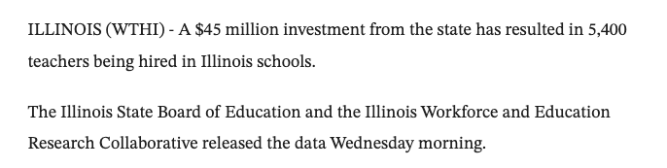

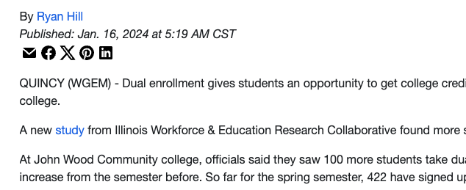
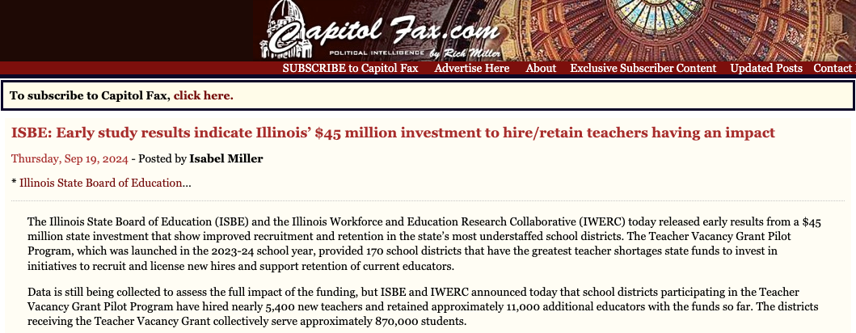
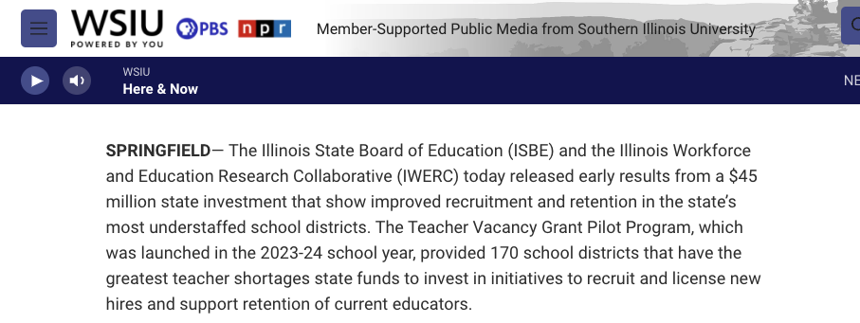
Media Mentions

Slide 9
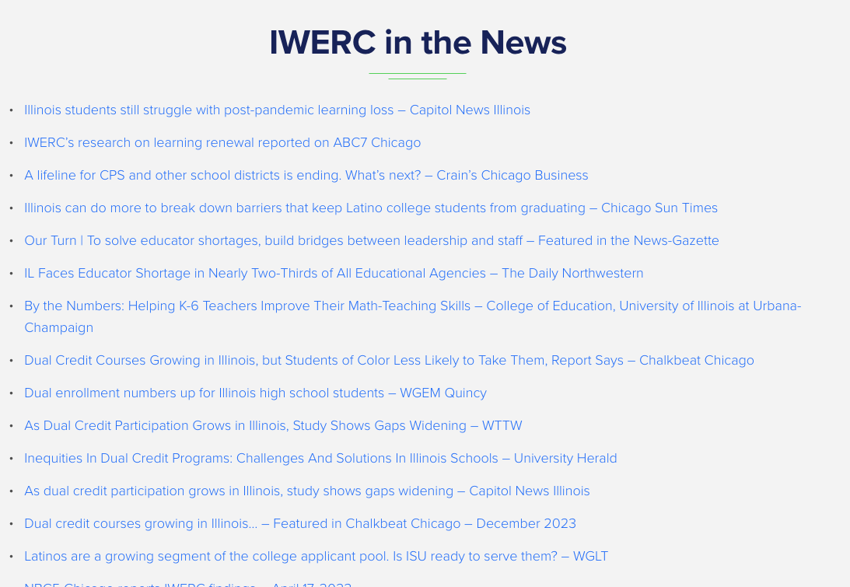
Media Mentions
Media mentions come from various sources, making them difficult to track and insufficient for providing clear insights into IWERC’s work.
Media mention records require manual updates and online tracking, which takes time and effort to verify across multiple sources.

Slide 10



Social Media
Linkedin
X

Slide 11
Social Media Issues
1.Manual Data Entry:the total impressions are tracked manually.
2.Fixed Growth Forecast: Monthly display forecasts are based on simple fixed growth rates of 2%, 5%, and 10%, instead of taking historical data into consideration, the accuracy of the forecast may be incomplete.
3.Lack of Impact Insights: The current analysis does not adequately showcase IWERC's influence and growth on social media.

Slide 12
solutions

Slide 13
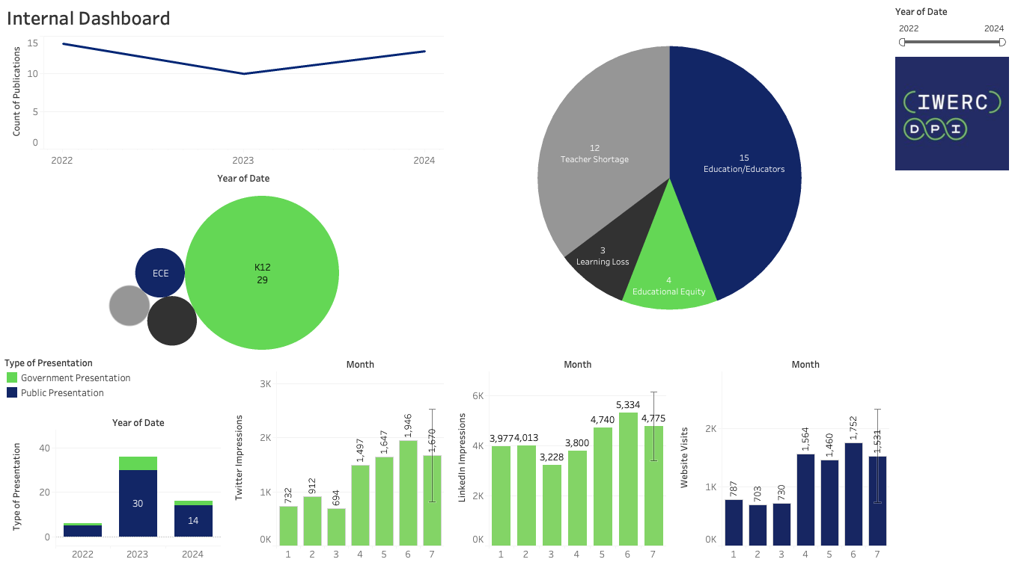
Version: 11/30/2024
Internal Tracking Dashboard
provides insights into IWERC’s operations, highlighting yearly trends, publication/ presentation types, and monthly activity to optimize strategic initiatives.

Slide 14
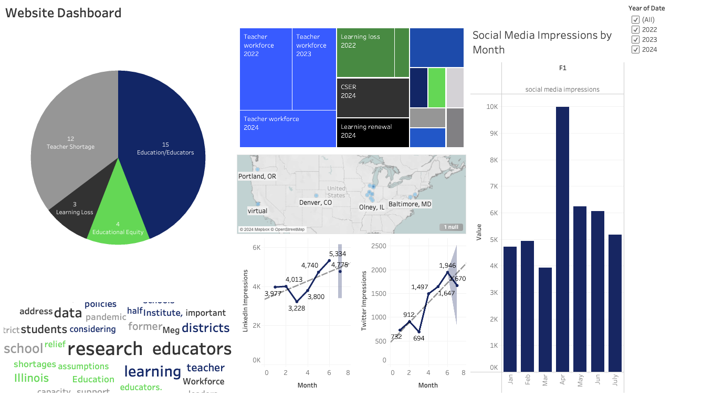
Version: 11/30/2024
Website
Dashboard
focuses on digital outreach, tracking social media impressions, geographic engagement, and keyword trends to enhance IWERC’s impact and support its mission of advancing education and equity.

Slide 15
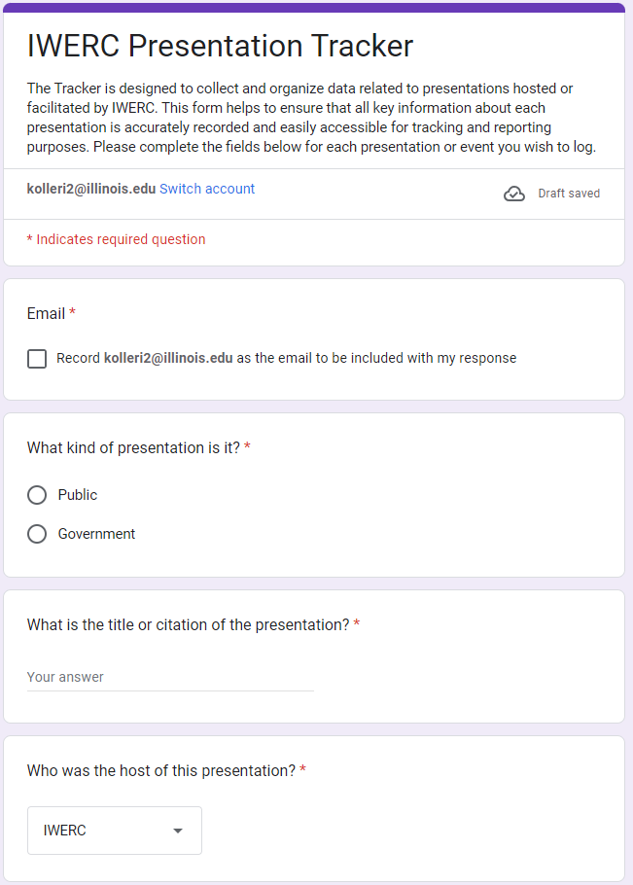
Presentations & Publications Tracking Solution
Introduce a manual entry form for stakeholders to input presentation details.
Ensure accurate data capture and correct formatting for seamless integration into interactive dashboards.
Feature "Impact Spotlights" on the website to highlight high-impact presentations.

Slide 16
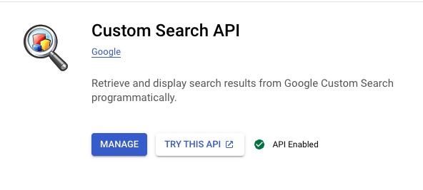

Data Extraction Tool
Create an automated tool to gather data using Google Search API and social media APIs and store it in an online data sheet

Slide 17
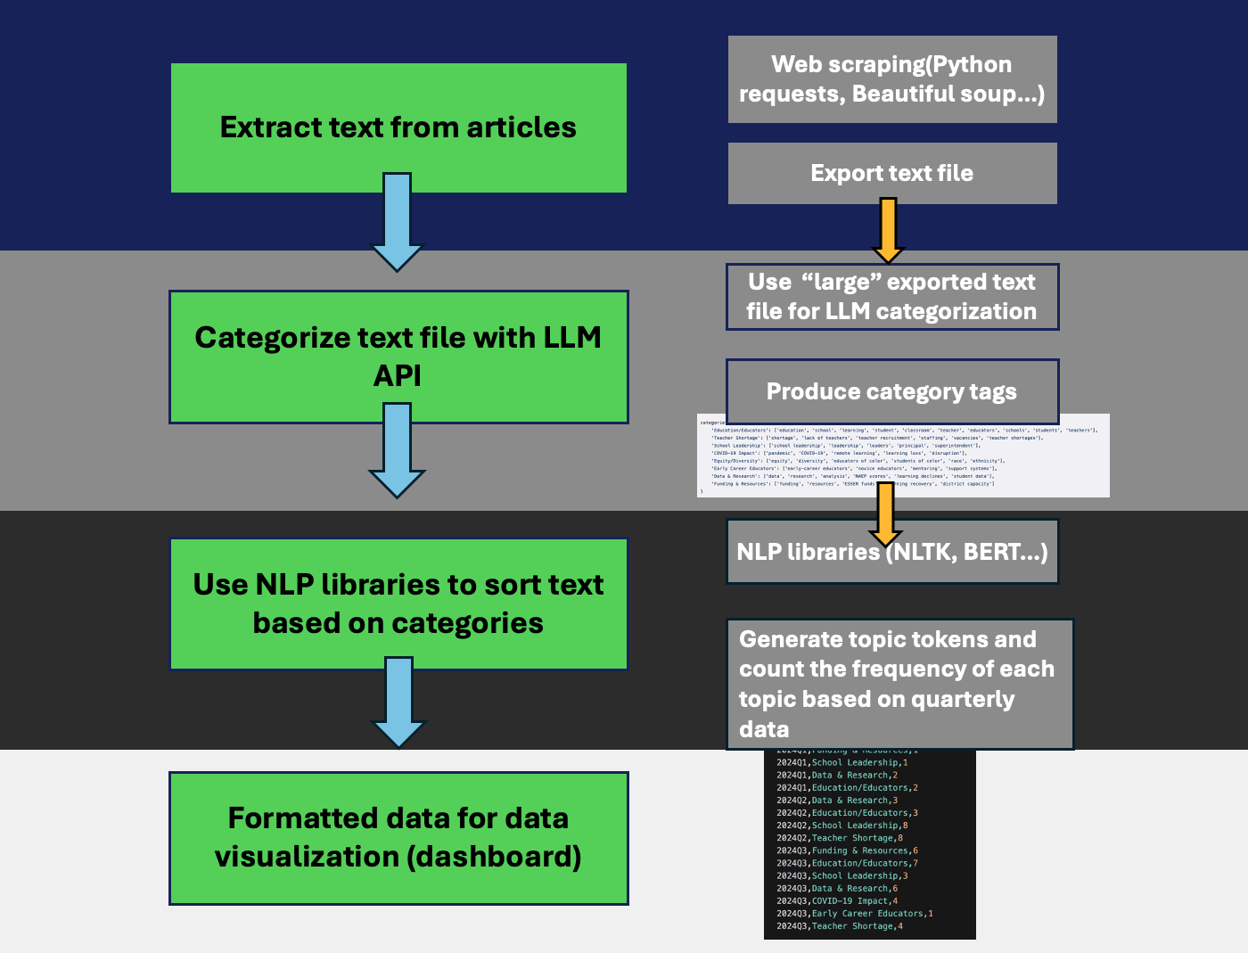
Media Mentions Categorization (Concept）
Notes:
Media Text Categorization Workflow

Slide 18

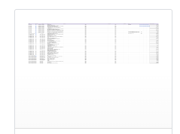

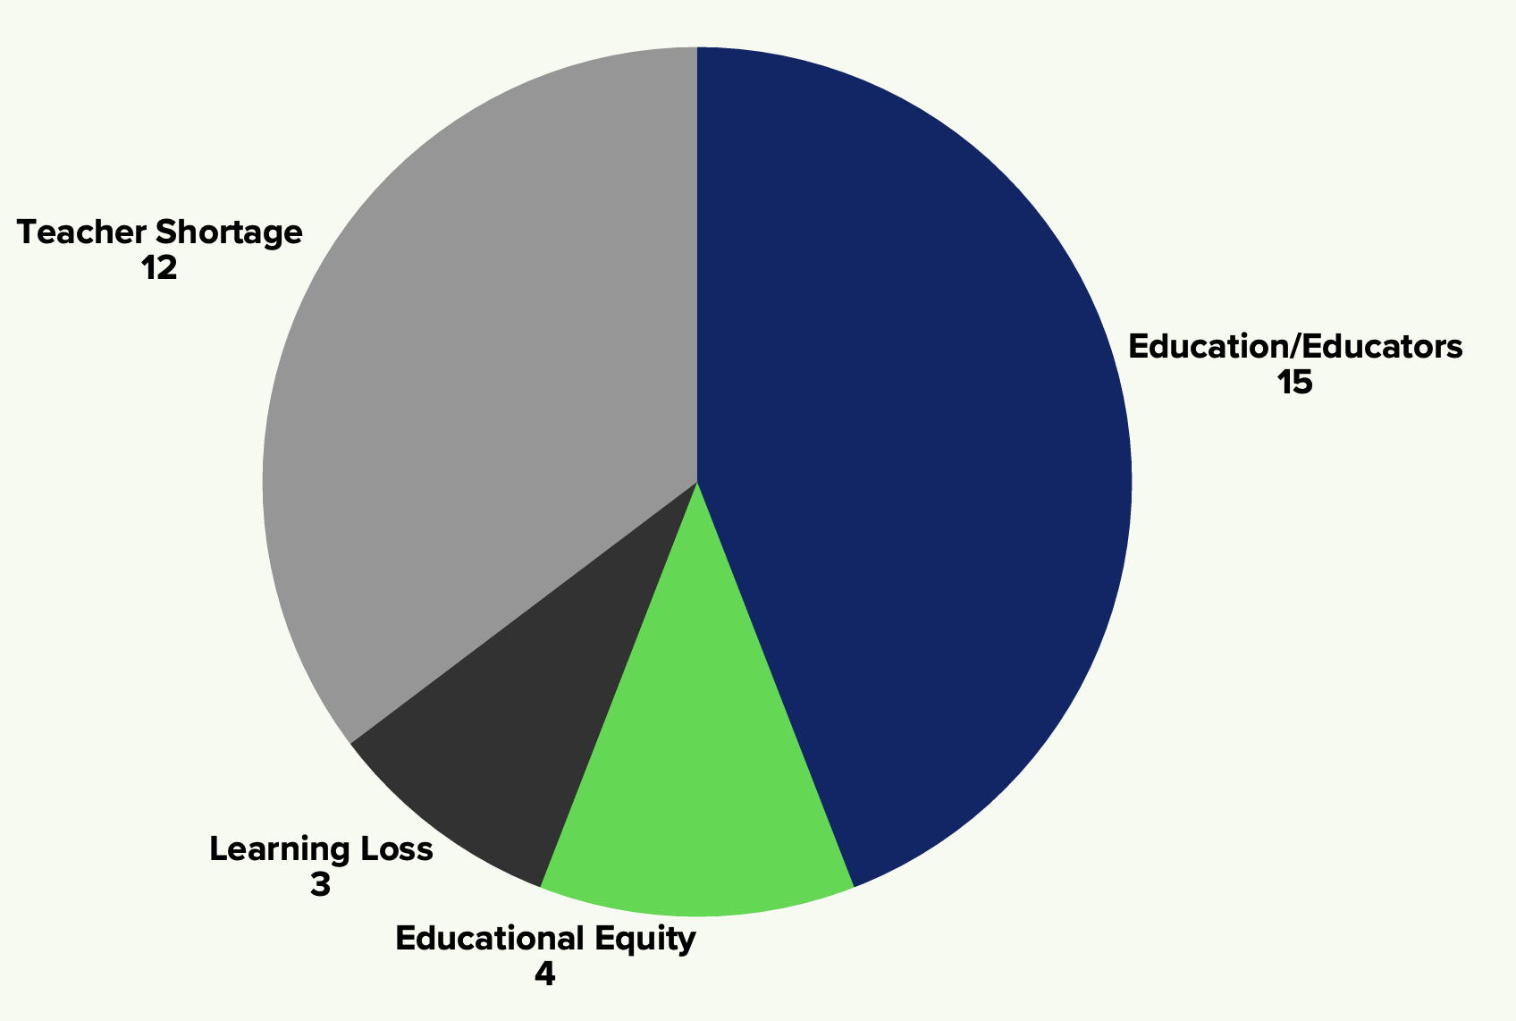
How Data Extraction Tool Works? (Automation)
Sorting, Categorization and Data Cleaning
Import data and update graphs regularly
Store data in Google sheet
Fetch social media & external website data through APIs

Slide 19
How Data Extraction Tool Works? (Automation)
Step 1
Step 2
Sorting, Categorization and Data Cleaning
Fetch social media & external website data through APIs
Step 4
Step 3
Import data and update graphs regularly
Store data in Google sheet
Notes:
© Copyright PresentationGO.com – The free PowerPoint and Google Slides template library

Slide 20

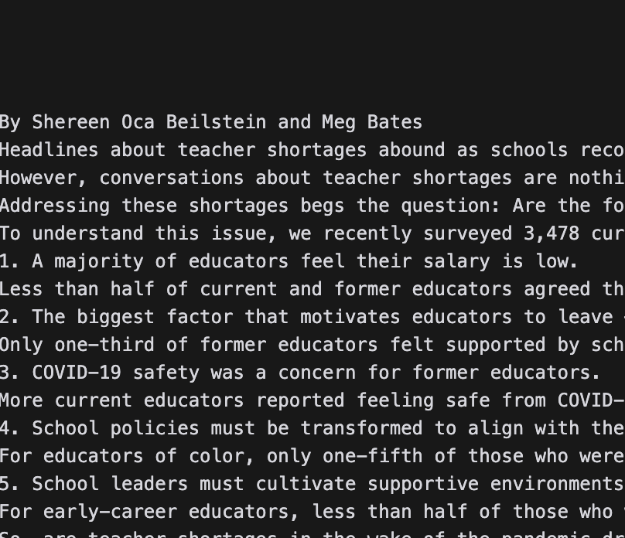
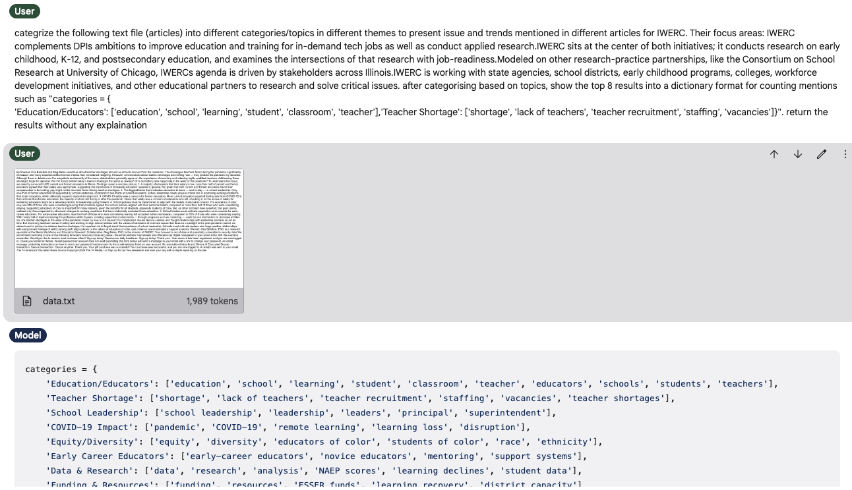
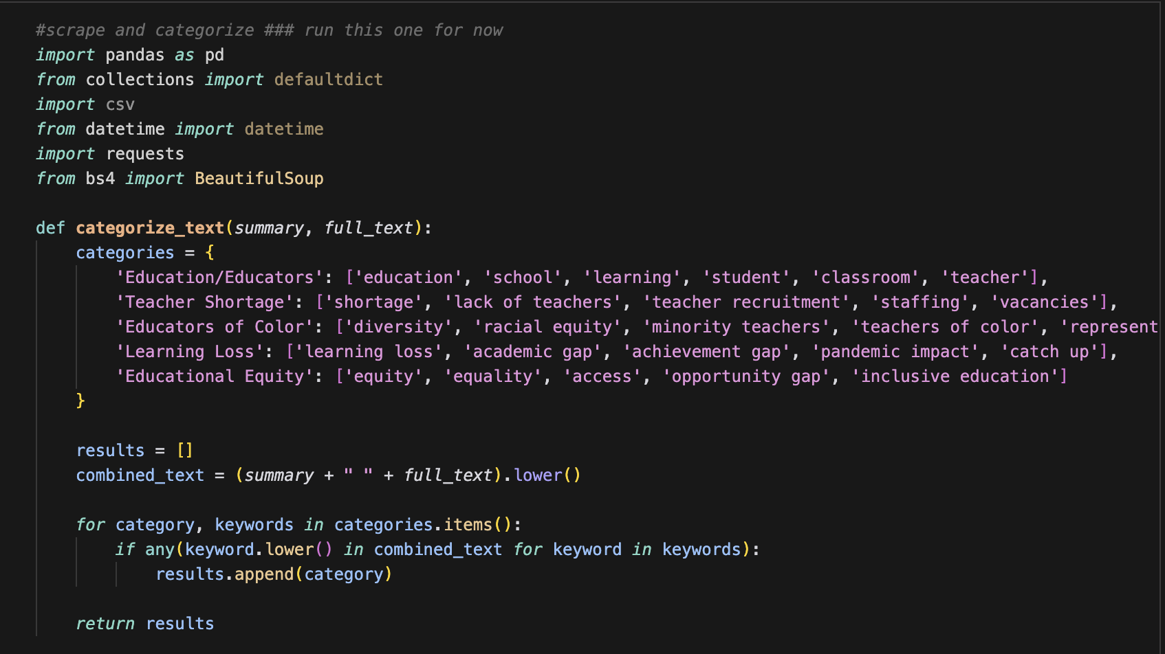
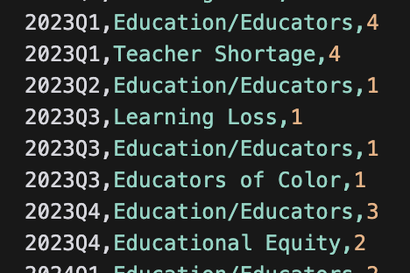
Media Text Categorization
Articles
Raw text
Generate Categories with Gemini (LLM) API
Data Visualization
Quarter & Topics mentioned
Sort raw text into different categories
Notes:
Media Text Categorization Workflow

Slide 21
Media Text Categorization
Step 1
Find Article Sources
Step 2
Extract Raw text
Step 4
Sort raw text into different categories
Step 3
Generate Categories with Gemini (LLM) API
Step 5
Data Visualization (Dashboard)
Notes:
© Copyright PresentationGO.com – The free PowerPoint and Google Slides template library

Slide 22
Conclusions
How our solutions will solve IWERC’s internal tracking issue
Our Solution introduces a manual entry form for stakeholders to input publications and presentation details, ensuring accurate data capture and correct formatting
The tool will use APIs to automatically gather data from various sources, significantly reducing manual data entry and improving efficiency for media mentions
The solutions will address manual data entry issues for social media metrics and provide more accurate forecasting and impact analysis of IWERC's social media presence
The solution will integrate this data into interactive dashboards, providing a comprehensive view of IWERC's academic output

Slide 23
Conclusions
Our Solution introduces a manual entry form for stakeholders to input publications and presentation details, ensuring accurate data capture and correct formatting
The tool will use APIs to automatically gather data from various sources, significantly reducing manual data entry and improving efficiency for media mentions
The solutions will address manual data entry issues for social media metrics and provide more accurate forecasting and impact analysis of IWERC's social media presence
The solution will integrate this data into interactive dashboards, providing a comprehensive view of IWERC's academic output

Slide 24

Thank You
Do you have any questions?

